Slide 1
CYBER CRIMES
COURSE: ACADEMIC PRESENTATION SKILLS FOR ENGINEERS
TEACHER : FULYA ÇALLIALP
NAME : MEHMET ALİ KAMALAK
NUMBER : 150720062

Slide 2
TABLE OF CONTETS
WHAT is ‘Cybercrime’?
Disadvantages
Types of Cybercrimes
Cyber security
Cyber security advantages

Slide 3

What ıs the cyber crıme
-> Cybercrime, or computer-oriented crime, is a crime that involves a computer and a network. The computer may have been used in the commission of a crime, or it may be the target.

Slide 4
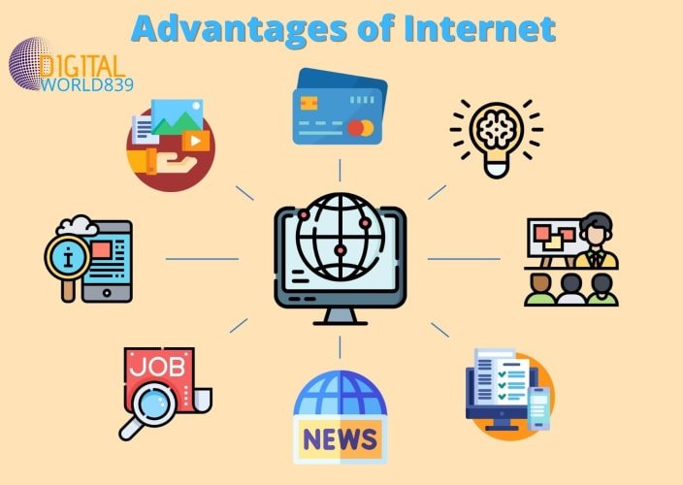
What ıs the cybercrıme?
Internet has given rise to new opportunities in every field we can say think to be it entertainment, business, sports or education.

Slide 5
dısadvantages

